Slide 1
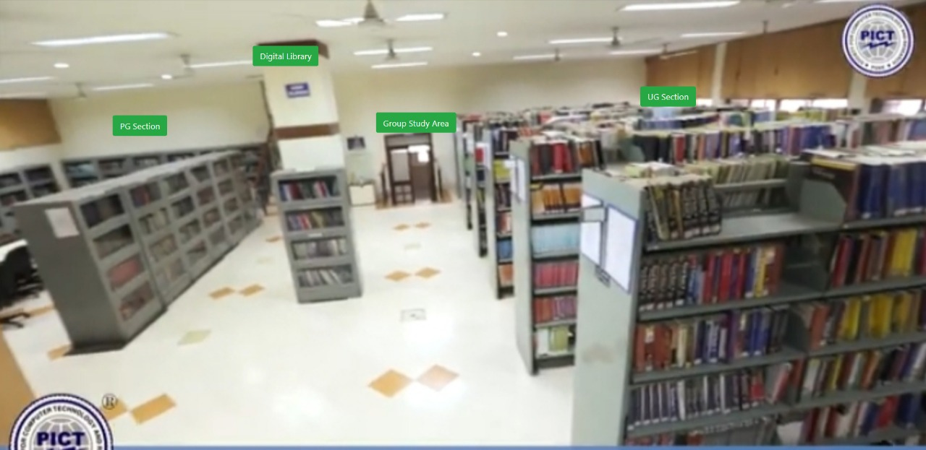
Pune Institute of Computer Technology (header)
Library
TIMING
Library: 8am- 8pm
Reading Hall:8am - 10pm (extended during examination)
PICT Central Library header
New arrivals
……
……
…….
Recommended reading
(Scrolling window)
List of topics to select from as shown below
(
or Auto recommendation (would require login)
Virtual tour of the library
For AI/ML: 1. Artificial Intelligence-
A Modern Approach
……….
…….
IoT
AI/ML
Cloud
`
List of resource persons in various areas of specialization
Example view
Notes:
On selecting Domain, Pop-up with Recommended books and material will appear.
In the Library tag, sub-menus will appear.

Slide 2
Pune Institute of Computer Technology (header)
Library
TIMING
Library: 8am- 8pm
Reading Hall:8am - 10pm (extended during examination)
Digital library
Services and facilities
Tour of the Library
About
New arrivals
……
……
…….
PICT Central Library header
E-books
E-journal
Video lectures
Institutional repository
(above are the links to User Interface for respective resources)
Recommended reading
(Scrolling window)
List of topics to select from as shown below
(
or Auto recommendation (would require login)
Virtual tour of the library
IoT
AI/ML
VLSI
`
List of resource persons in various areas of specialization
Example view
Notes:
List of exam notice, and books recommendation will be available after login either as a guest or staff/student.

Slide 3
Pune Institute of Computer Technology (header)
Library
TIMING
Library: 8am- 8pm
Reading Hall:8am - 10pm (extended during examination)
PICT Central Library header
New arrivals
……
……
…….
Recommended reading
(Scrolling window)
List of topics to select from as shown below
(
or Auto recommendation (would require login)
Service and facilities
Virtual tour of the library
Information about competitive exams
Last date to fill forms Competitive exams like Gate, GRE etc.
Links to government sectors for further education and jobs
Guidelines or links to websites providing opportunities like hackathons or competitions
IoT
AI/ML
VLSI
`
List of resource persons in various areas of specialization
Example view
Notes:
On Login.
On clicking on the image next view will appear for Virtual tour

Slide 4
Pune Institute of Computer Technology (header)
Library
TIMING
Library: 8am- 8pm
Reading Hall:8am - 10pm (extended during examination)
PICT Central Library header
New arrivals
……
……
…….
Recommended reading
(Scrolling window)
List of topics to select from as shown below
(
or Auto recommendation (would require login)
Service and facilities
Virtual tour of the library
Back
Information about competitive exams
Last date to fill forms Competitive exams like Gate, GRE etc.
Links to government sectors for further education and jobs
Guidelines or links to websites providing opportunities like hackathons or competitions
IoT
AI/ML
VLSI
`
Main door
Reading hall
List of resource persons in various areas of specialization
Example view
Notes:
For Virtual Tour.
From Main door -> Slide 5
From Reading Hall -> slide 8
All leaf nodes will go to slide 8.
From Main door-> Group Study area -> Slide 7

Slide 5
Pune Institute of Computer Technology (header)
Library
TIMING
Library: 8am- 8pm
Reading Hall:8am - 10pm (extended during examination)
PICT Central Library header
New arrivals
……
……
…….
Recommended reading
(Scrolling window)
List of topics to select from as shown below
(
or Auto recommendation (would require login)
Service and facilities
Virtual tour of the library
Back
Information about competitive exams
Last date to fill forms Competitive exams like Gate, GRE etc.
Links to government sectors for further education and jobs
Guidelines or links to websites providing opportunities like hackathons or competitions
IoT
AI/ML
VLSI
`
Stack Area
Periodicals/ Magazines
PG Section
Reference Section
Group Study Area
List of resource persons in various areas of specialization
Example view

Slide 6
Pune Institute of Computer Technology (header)
Library
TIMING
Library: 8am- 8pm
Reading Hall:8am - 10pm (extended during examination)
PICT Central Library header
New arrivals
……
……
…….
Recommended reading
(Scrolling window)
List of topics to select from as shown below
(
or Auto recommendation (would require login)
Service and facilities
Virtual tour of the library
Back
Information about competitive exams
Last date to fill forms Competitive exams like Gate, GRE etc.
Links to government sectors for further education and jobs
Guidelines or links to websites providing opportunities like hackathons or competitions
IoT
AI/ML
VLSI
`
Stack Area
Periodicals/ Magazines
PG Section
Reference Section
Group Study Area
List of resource persons in various areas of specialization
Example view
Notes:
View for all sections of Main door. The menu will remain constant for the 3 sections, namely Stack Area, Periodicals and PG section

Slide 7
Pune Institute of Computer Technology (header)
Library
TIMING
Library: 8am- 8pm
Reading Hall:8am - 10pm (extended during examination)
PICT Central Library header
New arrivals
……
……
…….
Recommended reading
(Scrolling window)
List of topics to select from as shown below
(
or Auto recommendation (would require login)
Service and facilities
Virtual tour of the library
Back
Information about competitive exams
Last date to fill forms Competitive exams like Gate, GRE etc.
Links to government sectors for further education and jobs
Guidelines or links to websites providing opportunities like hackathons or competitions
IoT
AI/ML
VLSI
`
Group Study Area
Motivational Book Section
List of resource persons in various areas of specialization
Example view

Slide 8
Pune Institute of Computer Technology (header)
Library
TIMING
Library: 8am- 8pm
Reading Hall:8am - 10pm (extended during examination)
PICT Central Library header
New arrivals
……
……
…….
Recommended reading
(Scrolling window)
List of topics to select from as shown below
(
or Auto recommendation (would require login)
Service and facilities
Virtual tour of the library
Back
Information about competitive exams
Last date to fill forms Competitive exams like Gate, GRE etc.
Links to government sectors for further education and jobs
Guidelines or links to websites providing opportunities like hackathons or competitions
IoT
AI/ML
VLSI
`
List of resource persons in various areas of specialization
Example view
Notes:
View of All leaf Nodes.

Slide 9
Link of certified courses graded and/or recommended by teachers or students or alumni
MIT edx - OOP
Coursera - BAI
Big data university
Service and facilities(links from current website)
Important links (Which are there on existing library page)
Students reviews / testimonials about resources
Staff publications:
Area wise segregated

